Slide 1
Flood Hazard, the Hydrological Cycle and Urbanism
Presented by
David Benny

Slide 2
Introduction
Water has always been a key component to human settlements because it is essential to life, and an advantage for trade, agriculture, industry, and social stability
Urbanism is the method of interaction of inhabitants of towns and cities (urban areas) with the built environment as well as the physical needs of urban societies
Notes:
Define the hydrological cycle putting flood and urbanization into perceptive as part of the cycle

Slide 3
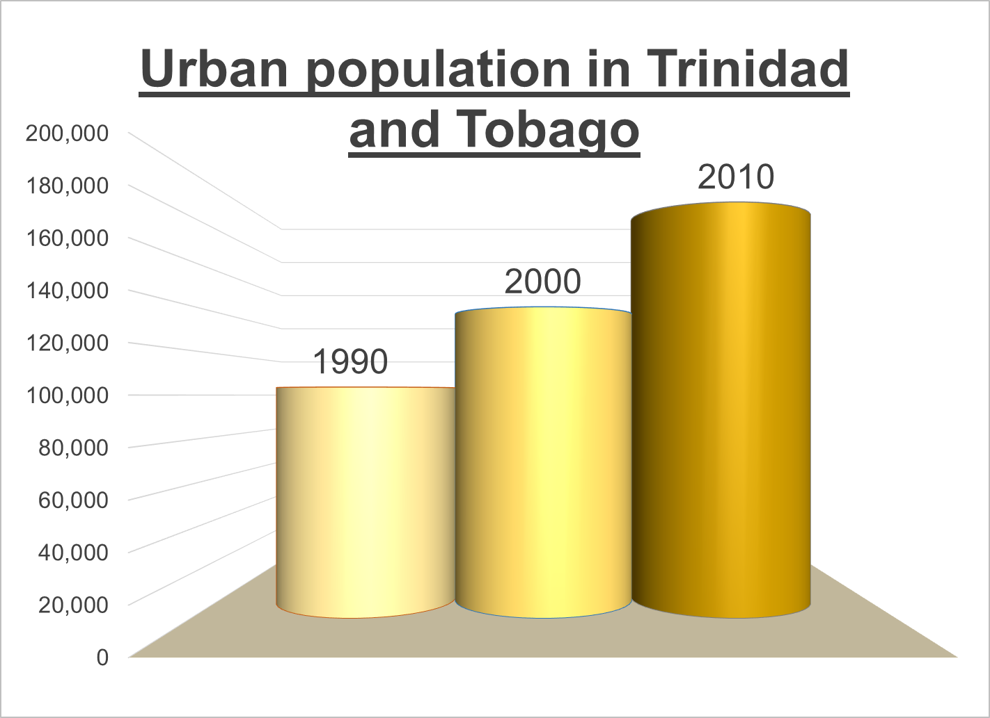
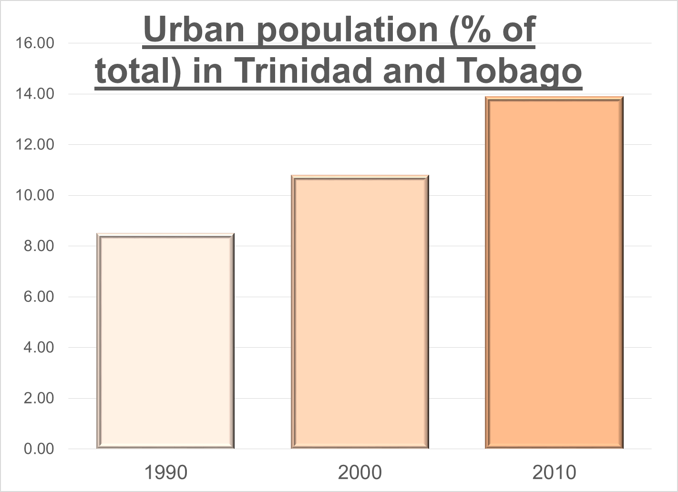
Background
Trinidad and Tobago
5,128 km² area
1.3 million population (CSO, 2013)
Gross Domestic Product (GDP) worth 24.64 billion US dollars in 2013 & represents 0.04 percent of the world economy. (World Bank Group, 2013)
Urban Population (CSO, 2013)

Slide 4
Background
Hydrological Overview (Water Resources Agency, 2005)
Flood Overview
More than 30 flooding events occur annually across Trinidad and Tobago but vary by type (ODPM 2012)
Riverine flooding eg. Caroni
Coastal flooding eg. Mayaro /Manzanilla
Flash flooding eg. Caparo
Urban flooding eg. Port of Spain
Annual Average | Trinidad | Tobago
Rainfall (mm) | 2200 | 1900
Runoff (mm) | 842 | 475
Evapotranpiration (mm) | 850-1000 | 1120
Temperature (ºC) | 26 | 26

Slide 5
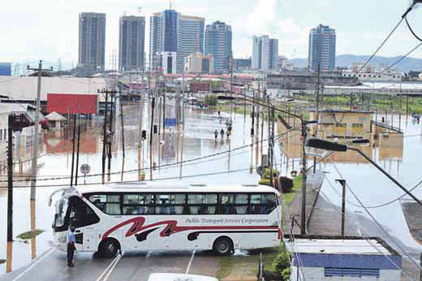
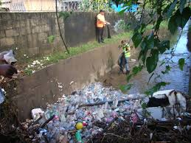
Major Causes of Flooding
Prolonged rainfall.
Intense/Heavy rainfall
Relief
Deforestation.
Poor land use practices
Urbanization
Improper waste disposal.
Quarrying
Notes:
Prolonged rainfall. When rain falls for a prolonged period of time, the soil can become saturated. When water is unable to infiltrate into the saturated soil, it is forced to flow over the soil, thus increasing surface runoff. Rivers that are unable to accommodate excess rain water overflow their banks onto neighbouring flood plains.
Intense/Heavy rainfall. When rain falls heavily; the rain drops hit the ground with a force. This can cause the rain drops to bounce off the soil instead of infiltrating into the soil. The water from the rain is then forced to flow over the surface instead, thus increasing the surface runoff.
Relief refers to the difference in height between the highest point and the lowest point on land. When rain falls, the surface runoff can move very quickly from mountainous or hilly areas to low lying areas making these low lying areas more prone to flooding.
Human activities that degrade the environment often increases flooding. These activities include:
Deforestation. The lack of vegetation encourages water to flow over the surface rather than infiltrate into the soil thus increasing surface runoff.
Poor land use practices. Slash and burn agriculture, over-cultivation and over-grazing eventually cause the soil to become infertile and unable to sustain vegetative growth. Consequently, the lack of green cover encourages water to flow over the surface rather than infiltrate into the soil thus increasing surface runoff.
Urbanization leads to the replacement of permeable soil with that of an impervious layer of pitch and concrete, through which water cannot infiltrate. This results in increased surface runoff which leads to flash flooding.
Improper waste disposal. Oftentimes, garbage that is not properly disposed enters into drainage systems and clogs drains. This obstructs the free flow of the water that enters into these drains causing water to back up during rainfall flooding the surrounding area. A build up of garbage can also obstruct the natural flow of water in rivers and streams.
Quarrying is the clearing of land for the removal of aggregates (mainly sand and gravel) which is to be utilized in the construction industry. The action of quarrying leaves land bare and devoid of any trees and shrubs hence increasing surface runoff produced.

Slide 6
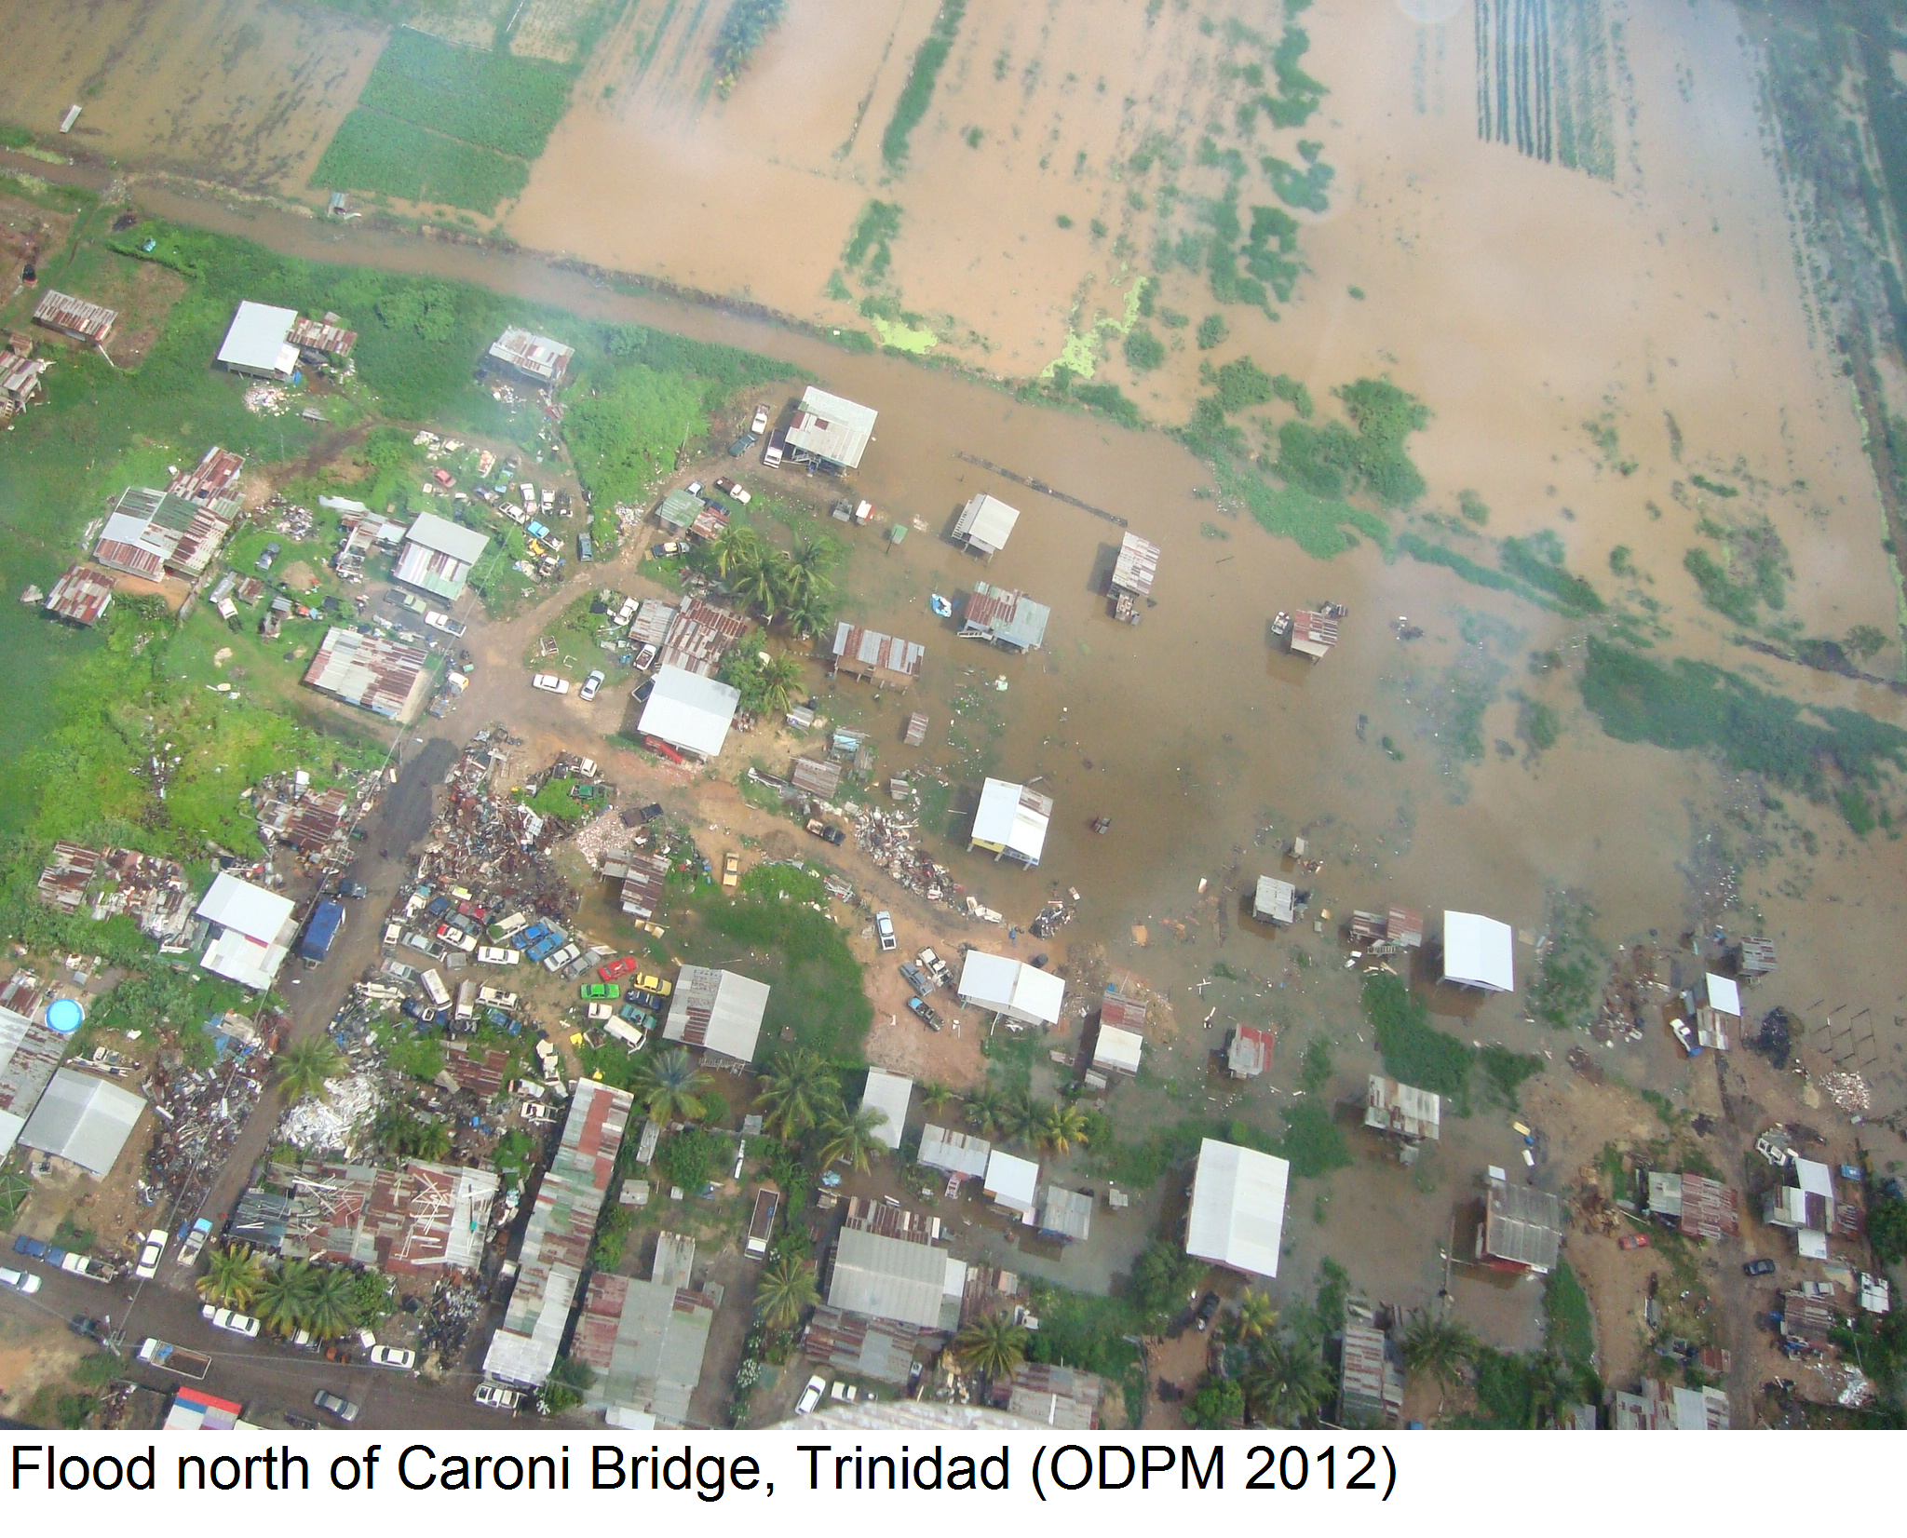
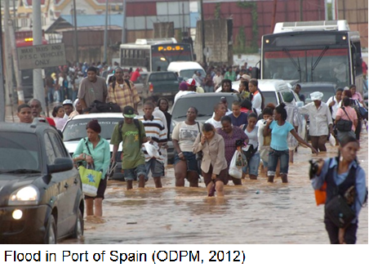
Flood Hazard
A flood event that poses a level of threat to life, health, property, livestock, the economy or the environment

Slide 7
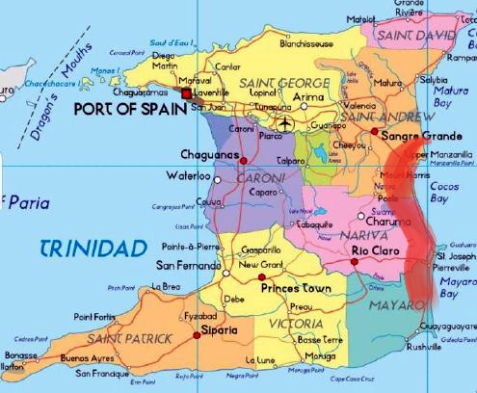
Flood Hazard & the Hydrological Cycle
The Mayaro/Manzanilla 2014 Experience
Flooding occurred between 12th and the 18th November, 2014
Ortoire River burst its banks causing riverine flooding
The Mayaro / Manzanilla area is coastal and tide catalyzed the flooding causing coastal flooding
Average rainfall between June to December – 147.7 mm (Candace Grey, Coastal Division, Ministry of Works, 2014)
Rainfall between 08th to 16th November, 2014 - 371.2 mm (Candace Grey, Coastal Division, Ministry of Works, 2014)
400 residents directly affected / 12,000 persons indirectly affected (ODPM, 2014)
Destroyed about 4km of the main road network between Mayaro and Sangre Grande (Dr. Surujrattan Rambachan,Minister of Works 2014)

Slide 8
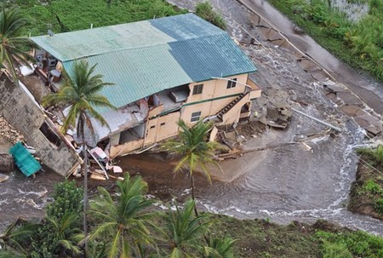
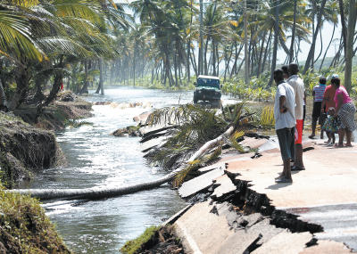
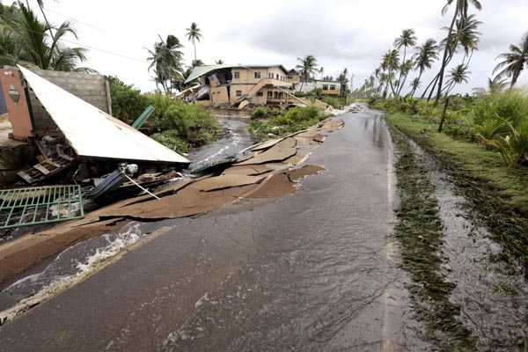
The Mayaro/Manzanilla 2014 Experience
The damage is estimated to cross $10 million including repairing the major link road
The road will take several weeks or even months to be restored causing its users to take a long route

Slide 9
Flood Hazard and Urbanism
The consequences of urban growth on the exposure, sensitivity but also as a driver of flooding are often underexposed. Yet, the rate of current urbanization is unprecedented and might increase future flood risk dramatically. (Verbeek et al, 2011)
The Diego Martin 2012 Experience
Flooding occurred between 11th and 13th August 2012
Significant land use changes observed in Diego Martin and surrounding areas over the last 20 years as acres of forested or savannah land converted to housing and commercial activity
Flooding commenced as flash flooding and developed into riverine flooding when the Diego Martin river burst its banks
On 11th August the Prime Minister Kamla Persad- Bissessar declared the area a disaster region after landslides claimed the lives of 2 persons

Slide 10
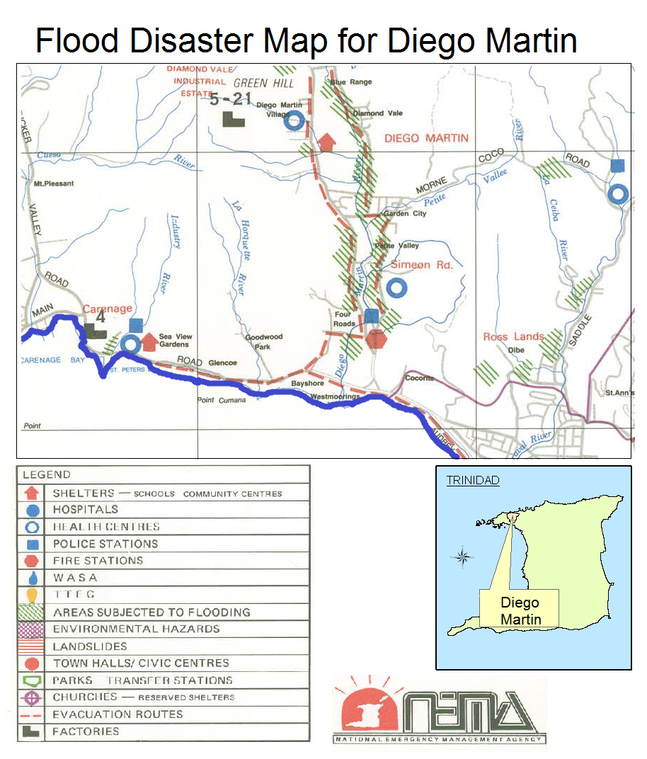

Slide 11
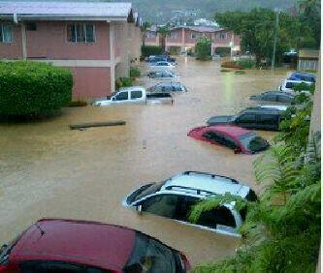
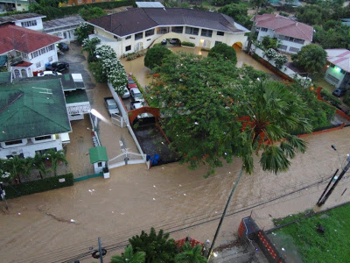
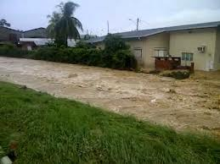
The Diego Martin 2012 Experience

Slide 12
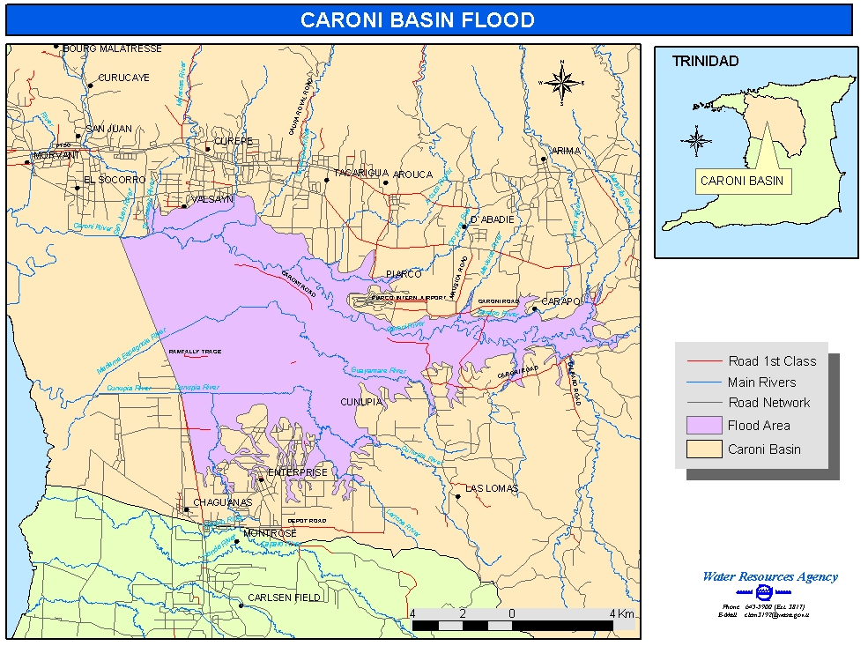
Flood Hazard, the Hydrological Cycle and Urbanism
Rapid urbanization causes major increase in contiguous impervious urban areas which in turn result in rising surface runoff levels and subsequent flooding. Rainfall events usually increase in magnitude by the influence of the urban microclimate compounds flooding
The Caroni River Basin Experience
The Caroni River Basin accounts for the most riverine flooding and the 2nd most flash flooding after Port of Spain and Caparo. (ODPM, 2012)

Slide 13
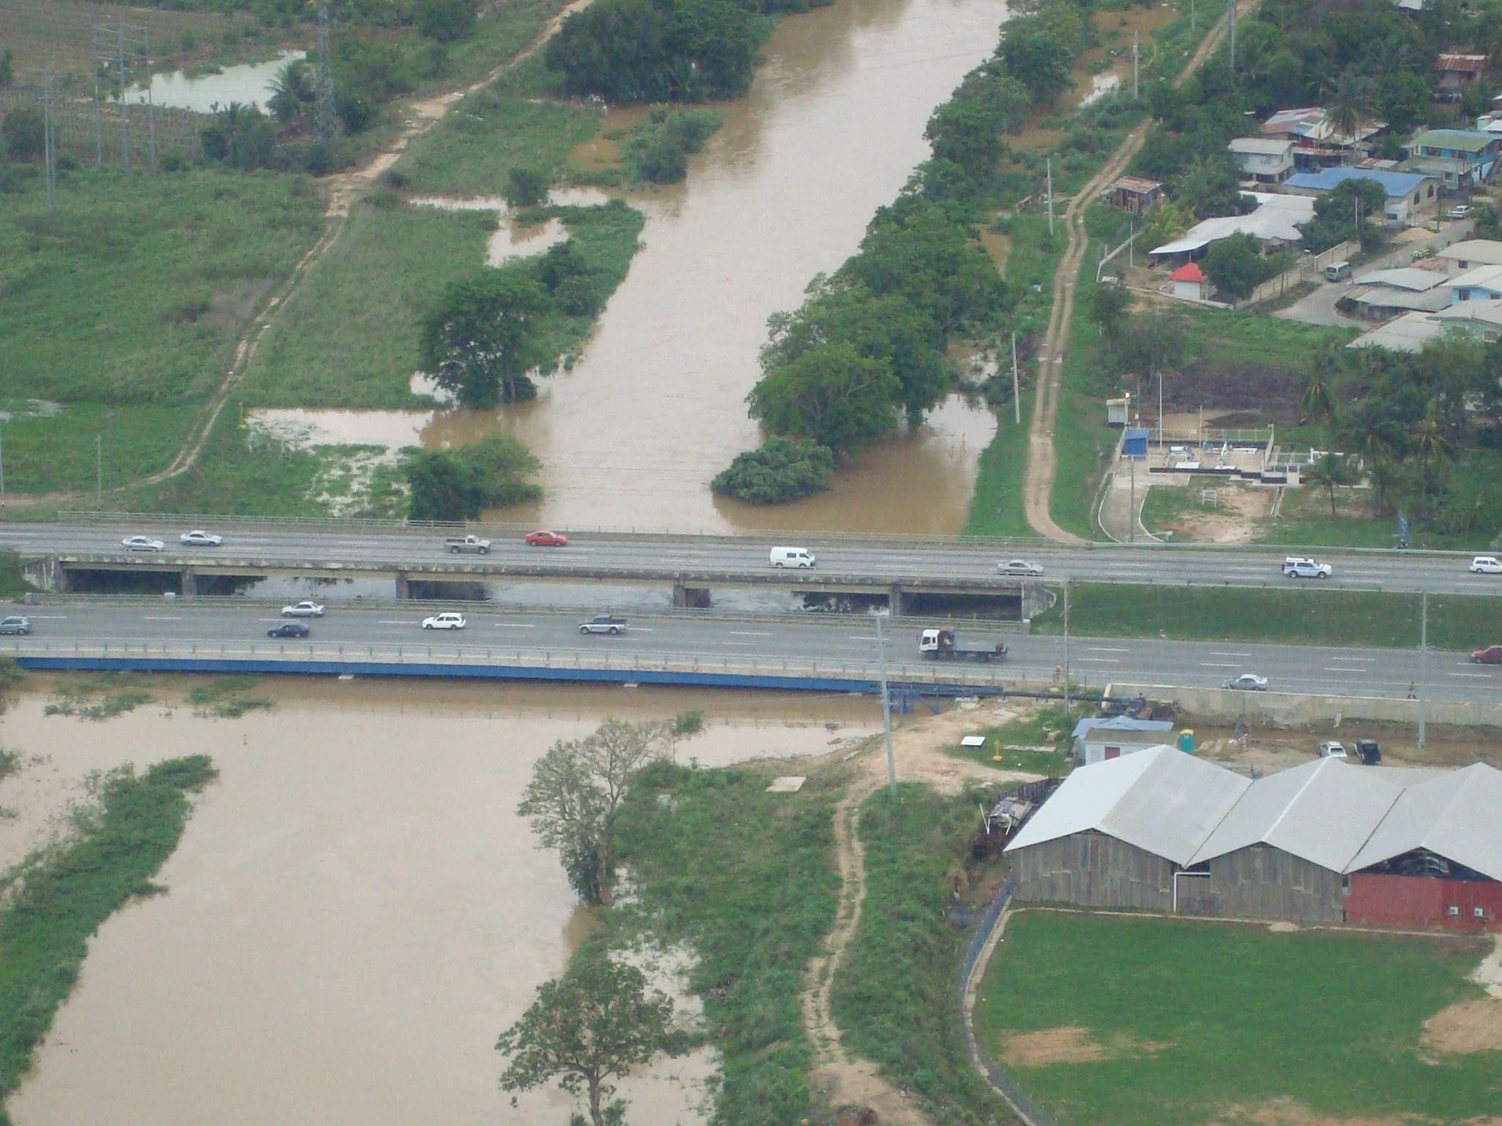
The Caroni River Basin Experience
Deforestation and Quarrying activities occurring in the initial stages of the Caroni River
The major tributaries of the Caroni River passes through heavily populated areas such as Arima, Arouca, Tacarigua, Curepe and San Juan
The Caroni River crosses several major link roads
The major pipe borne water supply comes from the Caroni Water Treatment Plant within the basin
Major Agricultural areas located within the basin
Flooding results in millions of dollars in losses
Flooding (flash or riverine) occur annually

Slide 14
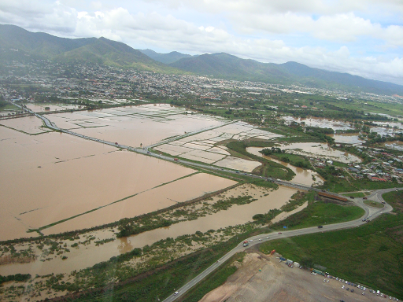
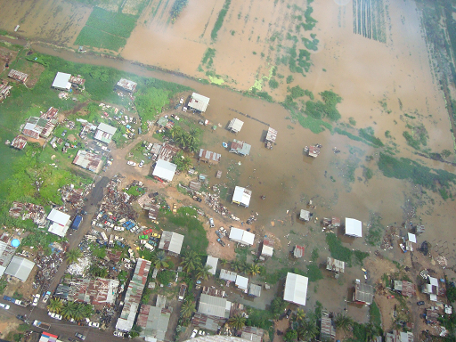
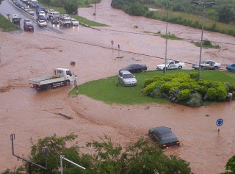
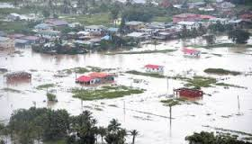
The Caroni River Basin Experience

Slide 15
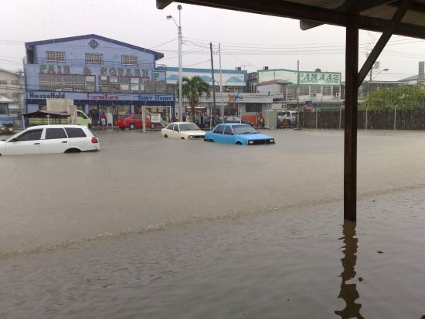
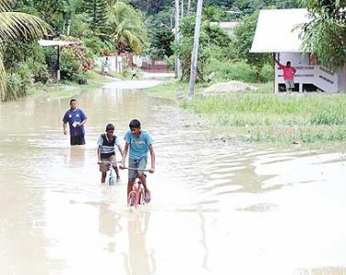
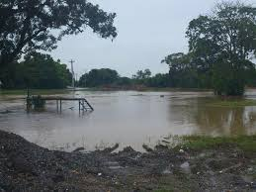
Flood Hazard from a Water Resources Perspective
The Caparo River Basin Experience
The basin area is 98 km².
The river is 42 km long
Flash flooding occur annually.
Riverine flood is also frequent

Slide 16
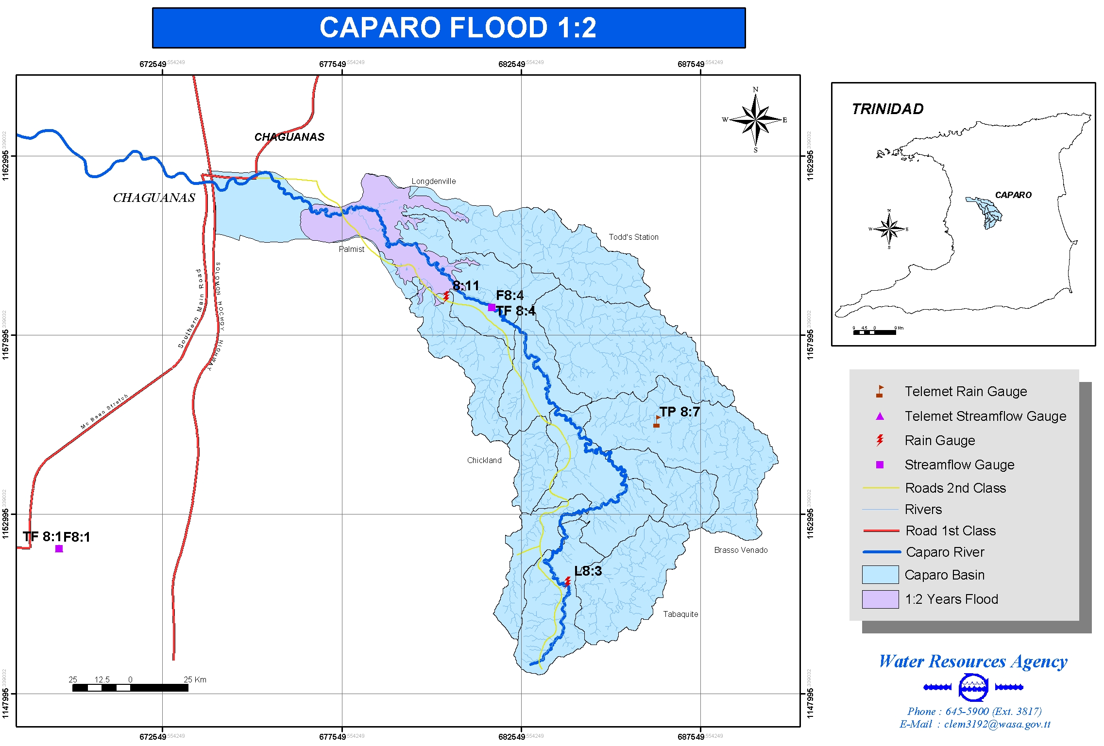
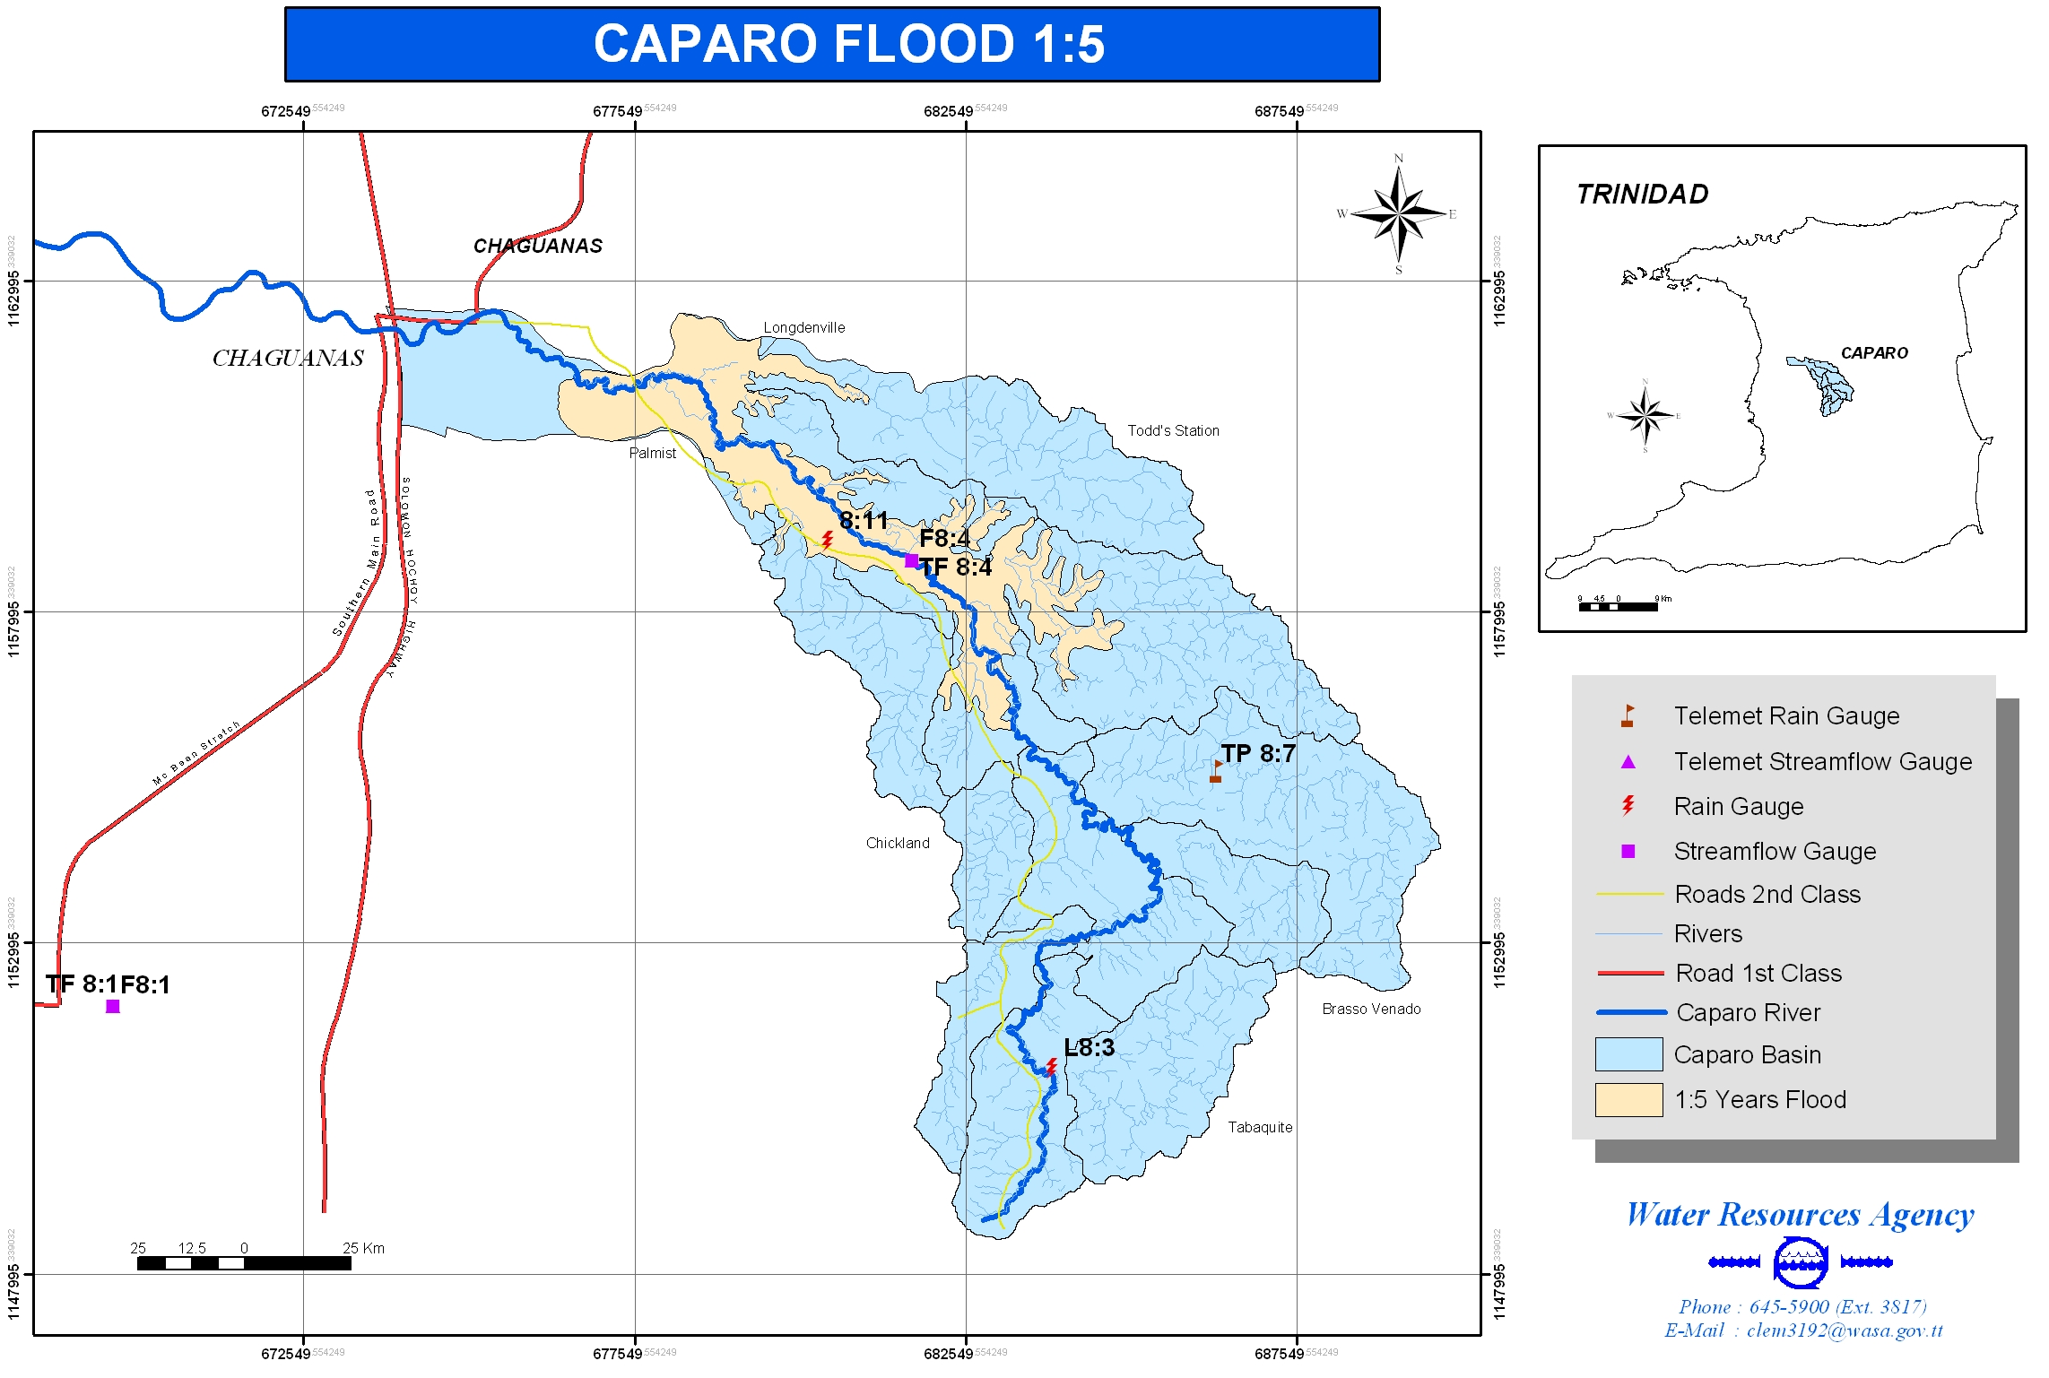
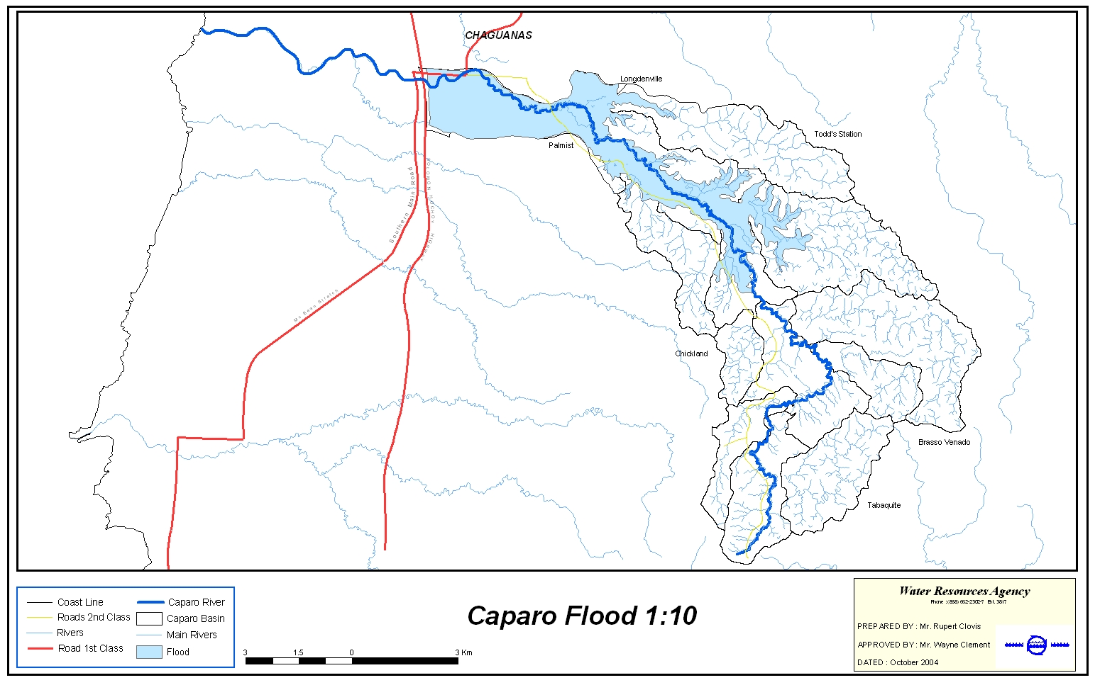
The Caparo River Basin Experience

Slide 17
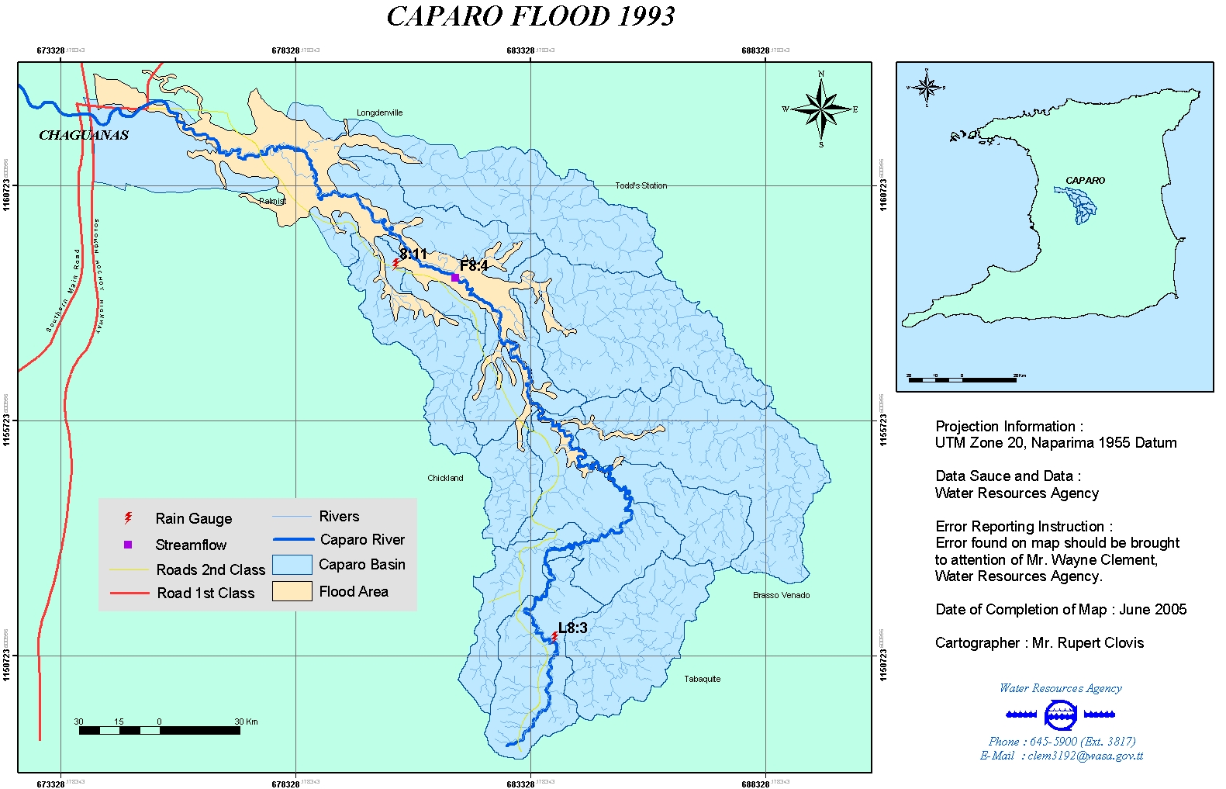
The Caparo River Basin Experience
Notes:
Actual flood event from 1993, a 1:50 flood event

Slide 18
Conclusion
A potential way to mitigate these threats is to develop more efficient urban growth strategies in which spatial planning is used to limit the sensitivity and exposure to flooding as well as the driving effect on precipitation.
‘Smart urban development’ which is often proposed as a vital strategy in greenhouse emissions reduction and energy consumption is a methodology that could be developed as a strategy for flood impact mitigation

